Slide 1
Paying for College:
Financial Aid Basics for Parents & Students
Holly Franquet
The College Place-CT
ECMC

Slide 2

The FAFSA: The Key to Financial Aid
(Free Application for Federal Student Aid)
www.fafsa.gov
The FAFSA opens on October 1 every year.
For academic year 2017-18, use 2015 taxes.

Slide 3

Early FAFSA Facts
  Oct. 1 is only an early opening date.
  A college processes a FAFSA after the student has been accepted.
  Most colleges have not moved up their financial aid priority deadlines.
  Most colleges will not send earlier financial aid award letters because of this change.
  Submitting a FAFSA produces an Expected Family Contribution (EFC), which may help you decide where to apply.

Slide 4
FAFSA Steps
  Make FSA IDs (student & one parent).
  Submit the FAFSA before deadlines.
  Enter all required info for student & parent(s):
    Name, SSN, DOB, etc.
    Income (& asset) info: for 2017-18, use 2015 taxes
    List of colleges (up to 10)
  Read confirmation page & find EFC.
  Read FSA emails & Student Aid Report (SAR).
  Read emails from college financial aid offices.
  Provide requested information to colleges.
  Understand your financial aid letters.

Slide 5

The FAFSA makes you eligible for…
  Grants: Free money!
  Scholarships: More free money!
  Work-study: Jobs for students
  Loans: Must be paid back

Slide 6

1a. Federal Grants
  Pell Grant: Up to $5,815: Need-based
  Use at any college.
  FSEOG: Up to $4,000: Need-based
  Awarded by each college
  TEACH grant: Up to $4,000: Merit-based
  www.StudentAid.gov

Slide 7
1b. Connecticut Grants
Roberta B. Willis Scholarship:
  Need-Based Award up to $4,500
  --Awarded by CT colleges
  Need/Merit-Based Award
  Up to $5,250 for a 4-year college
  Up to $4,650 for a 2-year college
  --Nominated by school (top 20%/high SAT/ACT)
CT Minority Teacher Incentive Grant
--Up to $5,000 and loan reimbursement of up to $2,500 (college juniors & seniors)
www.ctohe.org
Notes:
Minority junior or senior enrolled in a CT teacher preparation program. Grants up to $5,000 a year for 2 years; loan reimbursement of $2,500 a year for up to 4 years of teaching in a CT public school. Nominations due October 15. Contact education deans at CT colleges listed on application.

Slide 8

1c. Institutional Grants
Colleges award different amounts depending on available funds & student’s financial need.
Submit the FAFSA before the priority deadline.

Slide 9

2. Scholarships
Awarded for many reasons
Awarded by…
Foundations
Businesses
Employers
Civic organizations and charities
Colleges

Slide 10


Sample Scholarships
Fairfield County Community Foundation: Minimum 2.7 GPA for most awards. $500-$5,000. Due Mar. 2017.
Elks National Foundation: 500 awards--$1,000 - $12,500/yr for 4 years. Due Nov. 30.
American Fire Sprinkler Association: 10 awards of $2,000. Due Apr. 7.
Big Y: About 160 CT winners/yr. Due Feb. 1.
Notes:
Community Foundation of NW CT

Slide 11


Finding Scholarships
Start locally.
Use a search engine:
  fastweb.com / collegeboard.org / scholarships.com
Try specific search terms online.
Use other helpful websites & books.
Avoid scholarship scams!
Notes:
Figure out how to track scholarships.

Slide 12
3. Federal Work-Study
Federal money given to colleges to employ students with financial need
Students are paid every week or two.
Earn up to the maximum awarded (average $1500 per year).
Apply on the FAFSA: “Are you interested in being considered for work-study?”
Say YES to work-study!

Slide 13

4. Loans
Federal Direct Loans for students
  ($5,500 @ 3.76% + 1.069% fee)
Federal PLUS Loans for parents
  (6.31% + 4.276% fee)
State of CT loans (CHESLA.org) (5.33-5.45% APR)
Private loans
College Grads – Class of 2015
70% took out loans.
Average debt: $35,000

Slide 14
CSS Profile –Another Application
Required by 250 private colleges & scholarship programs.
CT: Conn College, Fairfield, SHU, Trinity, Wesleyan, Yale
Available at www.collegeboard.org.
Fee: $9 for application & $16 per school.

Slide 15

Financial Aid Advice
Apply by your colleges’ deadlines.
Provide student AND parent information.
Read ALL college correspondence.
Understand how much each college is offering vs. your cost of attendance.
Consider a financial aid appeal.
Know how you will pay your college bill BEFORE accepting the admission offer.
Send your deposit by May 1.

Slide 16
Cost of Attendance 2016-2017
Compare public & private colleges:
Uconn
Fairfield university
Tuition: $11,224
Fees: $ 2,842
Room & board: $12,436
Total DIRECT cost: $26,502
Books & supplies: $ 850
Expenses: $ 1,700
Transportation: $ 1,100
Total INDIRECT cost: $ 3,650
Cost of Attendance: $30,152
Tuition: $45,350
Fees: $ 650
Room & board: $13,860
Total DIRECT cost: $59,860
Books & supplies: $ 1,150
Expenses: $ 930
Transportation: $ 800
Total INDIRECT cost: $ 2,880
Cost of Attendance: $62,740
Notes:
UConn branches are less expensive.

Slide 17
CT Community Colleges
SCHOOL YEAR 2016-2017
PELL GRANT (MAX.) $5,815
TUITION & FEES (F/T) - $4,188
BOOKS (estimate) - $1,000
REFUND TO STUDENT $ 627
The maximum federal Pell grant covers tuition, fees,
& books for full-time community college students.
Refunds are distributed each semester.

Slide 18

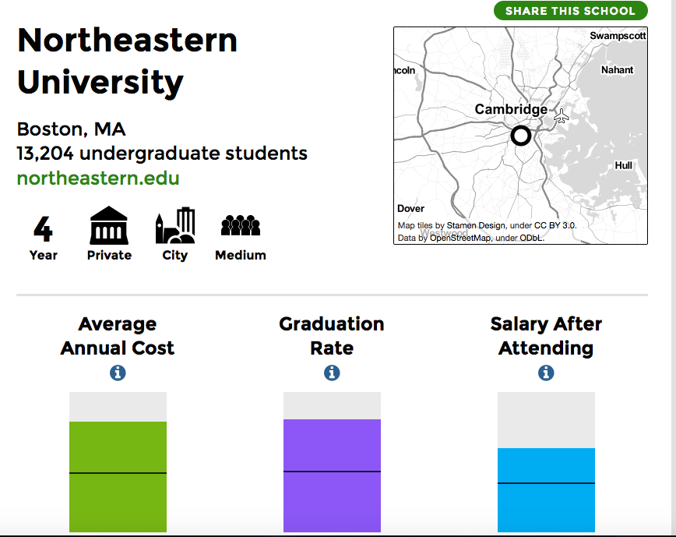

Financial Aid Tools
Net Price Calculators: on college websites
CollegeScorecard.ed.gov
CollegeAbacus.org
Pell.CollegeAbacus.org
StudentAid.gov (also YouTube)

Slide 19
Example: Net Price Calculator
Quinnipiac University for On-Campus Student
Family income = 0
Direct costs (paid to college):
--Tuition & fees $43,940 (half in fall/spring)
--Room & board $15,170 (half in fall/spring)
Indirect costs ($ you need):
--Books $ 800 (college’s estimate)
--Transportation/expenses $ 2,000 (college’s estimate)
Cost of attendance $61,910
Grants & scholarships $30,085
Federal Direct Loan $ 5,500 (max.)
TOTAL FINANCIAL AID $35,585
The “gap” is $23,525 for direct costs.
Student may also earn $2,000 through work-study.
Notes:
Zero income. Family of 3. Top rank & max SAT scores. Tuition & fees $43,940. Room & board $15,170. Gap is $8,355 if R&B are removed. 30 miles from HCC.

Slide 20



Final Advice:
What can we do now?
Have an honest family talk and make a plan.
Save what you can.
Apply for scholarships NOW.
Cut expenses: cable, Internet, cell phone, dining out, clothing, bank/credit card fees.…
Get a job or a second job.
Attend the best fit college that offers the best financial aid package.

Slide 21



The College Place-CT/ECMC www.ecmc.org/tcp-survey
Holly Franquet, Director
Office: B-110 at Housatonic CC
O: (203) 335-0381 C: (203) 455-7858
www.ecmc.org
ConnecticutTCP@ecmc.org
The College Place-CT

Slide 22


What is Financial Aid?
Any money
provided to students and families
to help pay for
postsecondary educational expenses

Slide 23
Financial Need = COA - EFC
Cost of Attendance (COA):
Tuition & fees
+ Room & board
+ Books & supplies
+ Transportation & personal expenses
+ Loan fees
Expected Family Contribution (EFC):
The amount, determined by the FAFSA, that your family can afford to pay for college.

Slide 24
A Financial Aid Award Letter
Expected Family Contribution = 0
☐Federal Pell Grant $5,730
☐Federal Supplemental Grant $ 700
☐University Grant $6,500
☐Federal Direct Loan $5,500
TOTAL FINANCIAL AID: $18,430
Direct costs (paid to college):
--Tuition, fees, room & board $20,500 (half in fall/spring)
Indirect costs ($ you need):
--Books $ 1,000 (college’s estimate)
--Transportation/personal expenses $ 1,500 (college’s estimate)
Cost of attendance $23,000

Slide 25
Another Award Letter
Expected Family Contribution = 0
☐Federal Pell Grant $5,730
☐University Scholarship $13,000
☐University Grant $8,200
☐Federal Direct Loan $5,500
TOTAL FINANCIAL AID: $32,430
Direct costs (paid to college):
--Tuition, fees, room & board $48,000 (half in fall/spring)
Indirect costs ($ you need):
--Books $ 1,000 (college’s estimate)
--Transportation/personal expenses $ 1,500 (college’s estimate)
Cost of attendance $50,500

Slide 26
Net Price Calculator: Example 2
Franklin & Marshall College for On-Campus Student
Expected Family Contribution = 0
Federal Pell Grant $ 5,775
College grants $53,865
Student employment $ 1,900
Federal Direct Loan $ 4,500
TOTAL FINANCIAL AID: $66,040
Direct costs (paid to college):
--Tuition, fees, room & board $63,370 (half in fall/spring)
Indirect costs ($ you need):
--Books $ 1,200 (college’s estimate)
--Transportation/personal expenses $ 1,470 (college’s estimate)
Cost of attendance $66,040
Notes:
39% of applicants admitted. Test optional.

