Slide 1
Sources of Financial Support
Federal Government - FAFSA
State Government – Gov’s scholarship
Colleges & Universities
Private organizations, clubs, schools, community organizations, competitions

Slide 2
Sources of aid by source and type

Slide 3
Terms to know
FAFSA – Free Application for Federal Student Aid
CSS Profile – helps colleges get a full picture
COA = Cost of Attendance
Tuition & fees, room & board, books, supplies, transportation
EFC = Expected Family Contribution
Award letter – Your financial aid award explained.
Free Money – Money that doesn’t have to paid back.

Slide 4
Step 1: cost of attendance(COA)
Go to each college website and search for:
COA - EFC = Your need
“NET PRICE CALCULATOR”
Notes:
All colleges require FAFSA for applying for aid
Some colleges require a second form be completed -
Css profile and other forms for institutional money
COA – in order to understand your actual cost
EFC – determined by the FAFSA for what your family can afford. What you get for aid will vary with each school.
EFC of $10,000. For UConn, your need is $24,800 – 10,000= $14,000
For University Of Harford - $46,900 – 10,000= $36,900
For Capital Com. College - $1946.00 is affordable by this family.
Award letter in April or before spells out what aid you will receive and in what form.

Slide 5
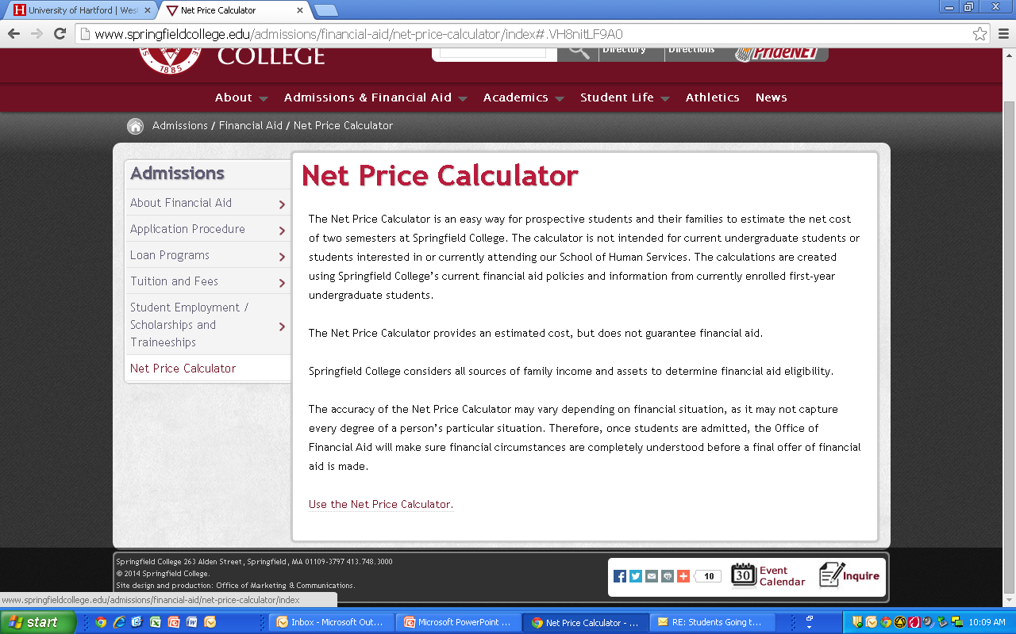
Colleges required to provide this

Slide 6
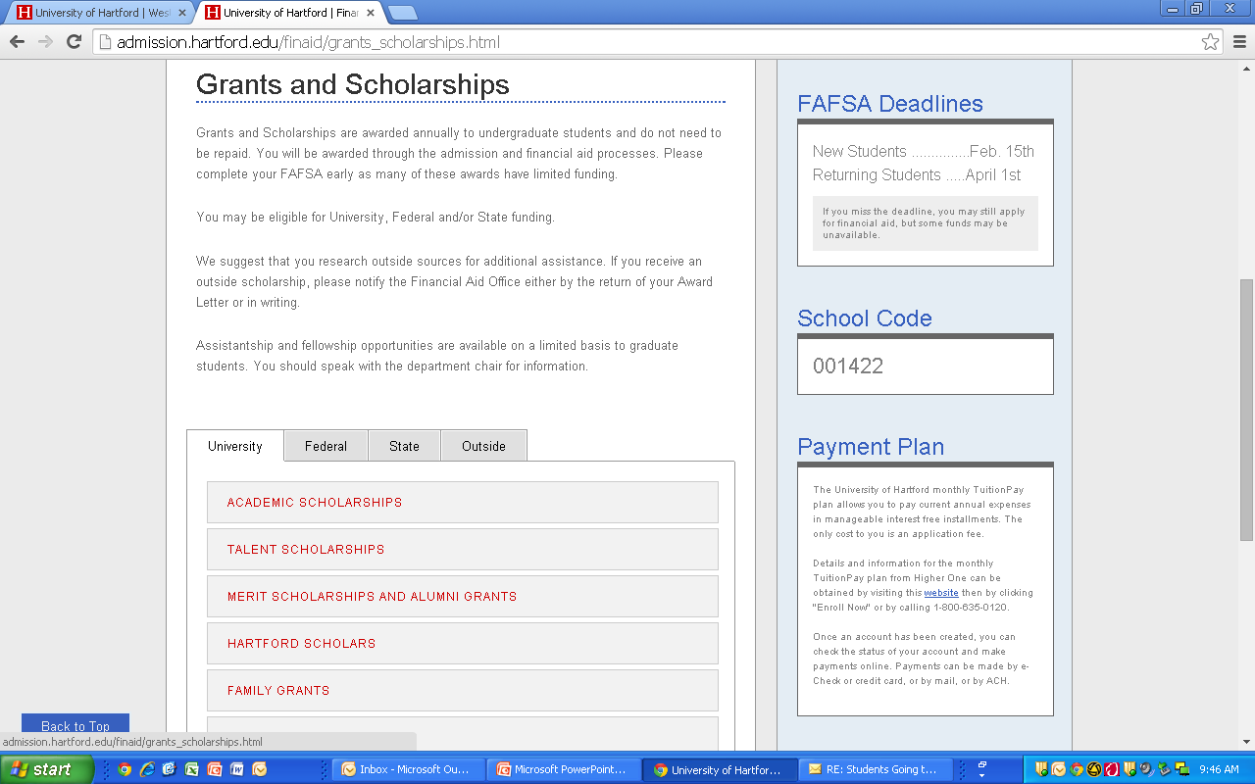

Slide 7
Top 5 things your should know…
Don’t rule out a college because of cost alone.
Compare costs before applying – Net Price Calculator
Complete FAFSA by deadline set by college
Beginning in October.
Seek advice from Financial aid experts
Compare financial aid awards
YOUR COUNSELOR CAN HELP!

Slide 8
Where the $ comes from
Need based money
Merit Money
Complete FAFSA
Complete other forms required – CSS Profile
State Grant if eligible
Institutional $ from the colleges
Private scholarships
Competitions, contests, etc.
Notes:
Well endowed schools have more money to give.
Schools for which you are a strong candidate will be more inclined to offer you free money.

Slide 9
Institutional $
Scholarships
Go on the websites for:
Qualifications
Deadlines
Process

Slide 10
Outside Scholarships
Naviance-scholarships tab
Daily announcements
Common Application – Scholar Snapp
School Counseling Office
Table

Slide 11
Websites:
Scholarship engines
www.Fastweb.com
www.Bigfuture.com
www.finaid.org
www.scholarships.com
Store Scholarships
www.pricechopper.com
www.bigy.com
http://coca-colascholars.org
CT State: www.ctohe.org/StudntsFamilies.shtml

